Slide 1
Software Development Life Cycle models

Slide 2
Software Process Model
A software process model is an abstraction of the software development process.
The goal of a software process model is to guide controlling and coordinating the tasks to achieve the end product and objectives as effectively as possible..
A model will define the following:
The tasks to be performed
The input and output of each task
The pre and post-conditions for each task
The flow and sequence of each task

Slide 3
Software Development Life Cycle Models (SDLC)
Waterfall model
V model
Incremental model
RAD model
Agile model
Iterative model
Prototype model
Spiral model

Slide 4
Factors in choosing a software process Models
Project Requirements
Factors
Cost of delay
Project Size
Customer involvement
Project Complexity
Familiarity with Technology
Project resources

Slide 5
Waterfall Model
The waterfall model is a sequential, plan driven-process.
Where you must plan and schedule all your activities before starting the project.

Slide 6
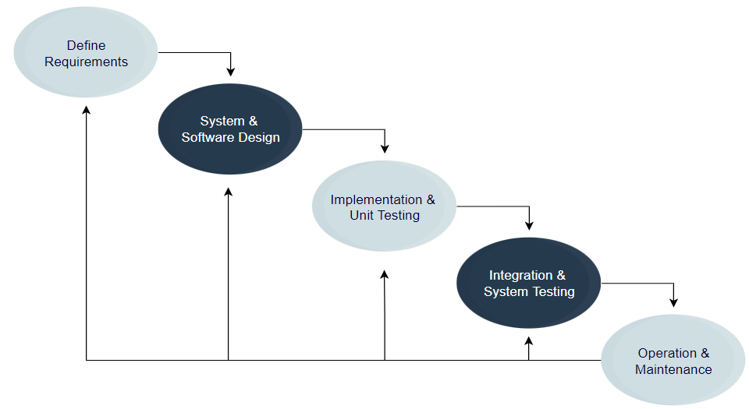
Waterfall Model Cont’d
Each activity in the waterfall model is represented as a separate phase arranged in linear order.
The waterfall model is the oldest paradigm for software engineering.
Classic Life Cycle Model

Slide 7
The activities involved in different phases (Waterfall Model)
1. Requirement Analysis (Phase)
Activities Performed
1. Capture all the requirements. 2. Do brainstorming and walkthrough to understand the requirements. 3. Do the requirements feasibility test to ensure that the requirements are testable or not.
Deliverables
RUD ( Requirements Understanding Document)

Slide 8
The activities involved in different phases (Waterfall Model) Cont’d
2. System Design Phase
Activities Performed
1. As per the requirements, create the design
2. Capture the hardware / software requirements.
3. Document the designs
Deliverables
HLD (High-Level Design document) LLD (Low-level design document)

Slide 9
The activities involved in different phases (Waterfall Model) Cont’d
3. Implementation Phase
Activities Performed
1. As per the design, create the programs / Code
2. Integrate the codes for the next phase.
3. Unit testing of the code
Deliverables
Programs Unit test cases and results

Slide 10
The activities involved in different phases (Waterfall Model) Cont’d
4. System Testing Phase
Activities Performed
Integrate the unit tested code and test it to make sure it works as expected.
Perform all the testing activities (Functional and non-functional) to ensure that the system meets the requirements.
3. In case of any anomaly, report it.
4. Track your progress on testing through tools like traceability metrics, ALM
5. Report your testing activities.
Deliverables
Test cases Test reports Defect reports Updated matrices.

Slide 11
The activities involved in different phases (Waterfall Model) Cont’d
5. System Deployment
Activities Performed
1. Make sure that the environment is up 2. Make sure that there are no sev defects open. 3. Make sure that the test exit criteria are met. 4. Deploy the application in the respective environment. 5. Perform a sanity check in the environment after the application is deployed to ensure the application does not break.
Deliverables
User Manual
Environment definition / specification

Slide 12
The activities involved in different phases (Waterfall Model) Cont’d
6. System Maintenance
Activities Performed
1. Make sure the application is running in the respective environment.
2. In case the user encounters and defect, make sure to note and fix the issues faced.
3. Incase any issue is fixed, the updated code is deployed in the environment.
4. The application is always enhanced to incorporate more features, and update the environment with the latest features.
Deliverables
List of production tickets
List of new features implemented.

Slide 13
When To Use SDLC Waterfall Model
Requirements are stable and not changed frequently.
An application is small.
The environment is stable.
The tools and techniques used are stable and are not dynamic.
Resources are well trained and available.

Slide 14
The advantages of using the Waterfall model
Simple and easy to understand and use.
For smaller projects, the waterfall model works well and yields the appropriate results.
Since the phases are rigid and precise, one phase is done one at a time. It is easy to maintain.
The entry and exit criteria are well defined, so it is easy and systematic to proceed with quality.
Results are well documented.

Slide 15
Disadvantages of using Waterfall model
Cannot adopt the changes in requirements
It becomes very difficult to move back to the phase.
Delivery of the final product is late as there is no prototype that is demonstrated immediately.
For bigger and more complex projects, this model is not good as the risk factor is higher.
Not suitable for projects where requirements are changed frequently.
Does not work for long and ongoing projects.
Since the testing is done at a later stage, it does not allow identifying the challenges and risks in the earlier phase. Hence, the risk mitigation strategy is difficult to prepare.

Slide 16
V –Model
V model is one of the most widely used software development processes.
V model is also called a verification and validation model.
Verification: Verification is a static analysis technique. In this technique, testing is done without executing the code. Examples include – Reviews, Inspection, and walkthroughs.
Validation: Validation is a dynamic analysis technique where testing is done by executing the code. Examples include functional and non-functional testing techniques.
There is no discrete phase called Testing, rather, testing starts right from the requirement phase.

Slide 17
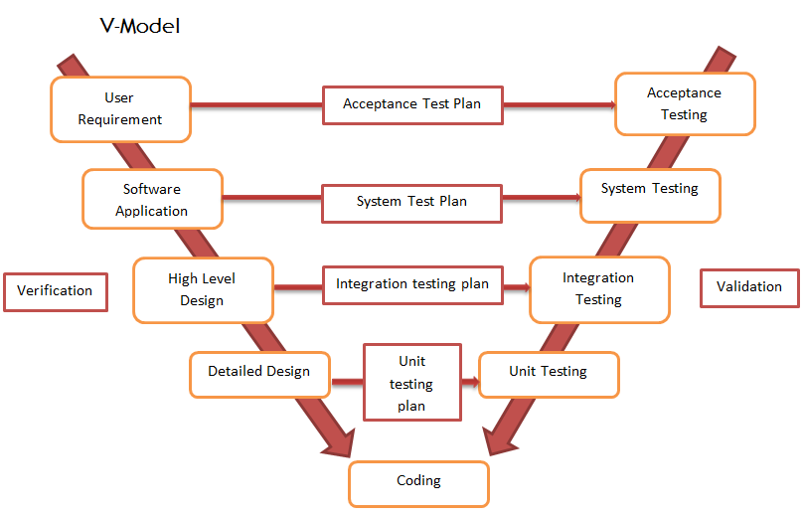

Slide 18
When To Use The V Model
The requirement is well-defined and not ambiguous.
Acceptance criteria are well defined.
The project is short to medium in size.
The technology and tools used are not dynamic.

Slide 19
The advantages of using the V-Model
Development and progress are very organized and systematic.
Works well for smaller to medium-sized projects.
Testing starts from the beginning, so ambiguities are identified from the beginning.
Easy to manage as each phase has well-defined objectives and goals.

Slide 20
Disadvantages of using V Model
Not suitable for bigger and more complex projects
Not suitable if the requirements are not consistent.
No working software is produced in the intermediate stage.
No provision for doing risk analysis, so uncertainty and risks are there.

